Slide 1
Clostridioides difficile:
Vancomycin & Ramoplanin
Reimon John E. Fernandez

Slide 2

Intro & Significance
Transcriptome comparing Clostridioides difficile (C. diff) gene expression when put in 2 different antibiotic environments - Vancomycin & Ramoplanin
Why?
To get a deeper understanding on Antibiotic resistance in the Healthcare world
Background
Vancomycin - broad spectrum
Ramoplanin - narrow spectrum

Slide 3



Materials And Methods
Ubuntu
Packages - hisat2, samtools, stringtie, gffcompare
File prep and decompression
RStudio
Analysis and visuals
National Center for Biotechnology Information
GFF
FASTA
FNA

Slide 4
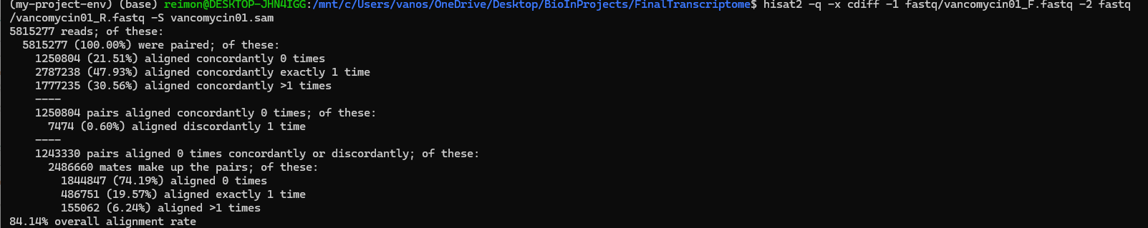
Results/Conclusions: Ubuntu
Vancomycin01 - Forward and Reverse Reads - 84.14% overall alignment rate
Vancomycin02 - Forward and Reverse Reads - 84.36% overall alignment rate
Ramoplanin01 - Forward and Reverse Reads - 86.56% overall alignment rate
Ramoplanin02 - Forward and Reverse Reads - 86.42% overall alignment rate

Slide 5
Results/Conclusions: Ubuntu
Concerns
Alignment rate - 80-90 range
Ideal - >90%
Sequences complexity
Contamination
Errors

Slide 6
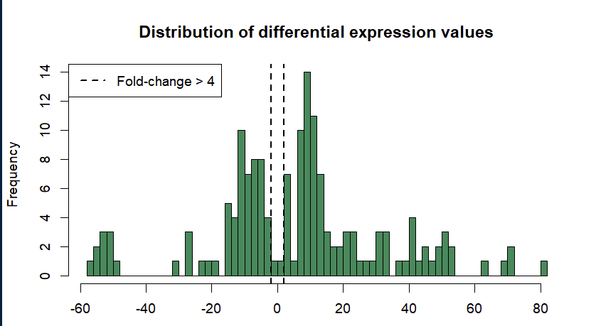
Results/Conclusions: RStudio
The figure plots the differential gene expression values between vancomycin and Ramoplanin environment. In this case, the emphasis is on the fold change between Ramoplanin and Vancomycin with the peak of the bell curve lying between 0 and 20 frequency differential.

Slide 7
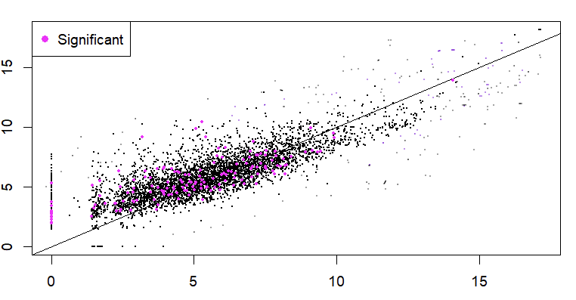
Results/Conclusions: RStudio
Vancomycin vs Ramoplanin FPKMs
Fragments per kilobase of Transcript
Visual of gene expression levels comparison
The spread is more prominent
When it comes to C. Diff gene expression, Vancomycin and Ramoplanin elicits similar levels of expression when used on C. diff, but....

